Slide 1

18CSS202J - COMPUTER COMMUNICATIONS
1

Slide 2
Course Objective:
The purpose of learning this course is to
Understand the basic services and concepts related to Internetwork
Understand the layered network architecture
Acquire knowledge in IP addressing
Exploring the services and techniques in physical layer
Understand the functions of Data Link layer
Implement and analyze the different Routing Protocols
Course Outcomes (CO):
At the end of this course, learners will be able to
Apply the knowledge of communication
Identify and design the network topologies
Design the network using addressing schemes
Identify and correct the errors in transmission
Identify the guided and unguided transmission media
Implement the various Routing Protocols
2

Slide 3

UNIT –II
IPv4 Addressing, Address space
Dotted Decimal Notation
ClassfulAddressing
Subnet Mask
Subnetting
Special Addresses
Classless Addressing
Private Address, NAT, Supernetting
Hub, Repeaters, Switch, Bridge
Structure of Router

Slide 4



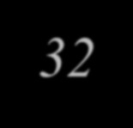





IPv4 ADDRESSES
An IPv4 address is a 32-bit address that uniquely and universally defines the connection of a device
(for example, a computer or a router) to the Internet.
The address space of IPv4 is 2³² or 4,294,967,296
Unique and Universal.
Two devices on the Internet can never have the same address at the same
time
Addressing system must be accepted by any host that wants to be connected to the Internet.

Slide 5

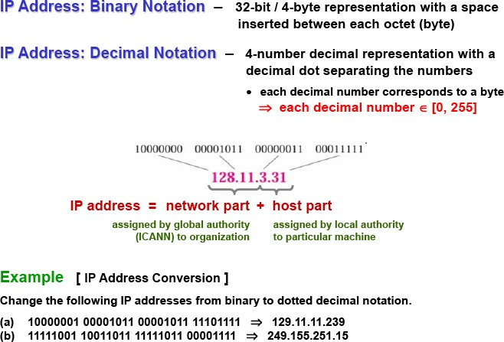
IPV4 NOTATIONS

Slide 6

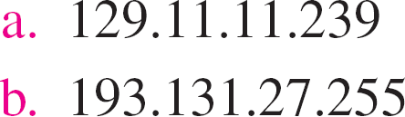
Solution
Change the following IPv4 addresses notation to dotted-decimal notation.
from
binary
Solution
We replace each group of 8 bits with its equivalent decimal number (see Appendix B) and add dots for separation.

Slide 7
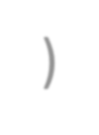
An easier way to remember IP addresses is by assigning to them a name.
(e.g., www.google.com), which is resolver through the Domain Name System (DNS).
Strictly speaking, an IP address identifies an interface that is capable of sending and
receiving IP datagrams.
One system can have multiple such interfaces.
Usually, hosts have only one interface (thus, one IP address), whereas routers have many interfaces (thus, many IP addresses).

Slide 8
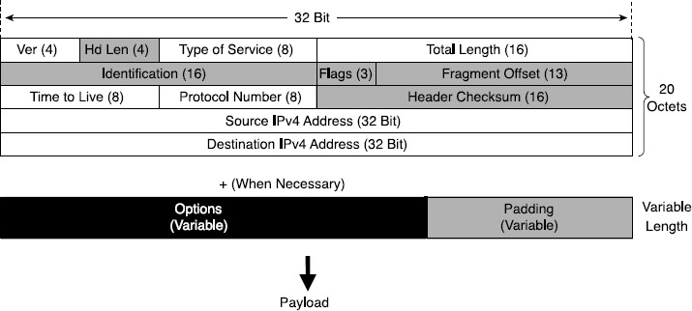
IPv4 Header Structure
basic IPv4 header contains 12 fields.
each field of the IPv4 header has a specific use.
Shaded field are removed in IPv6.

Slide 9



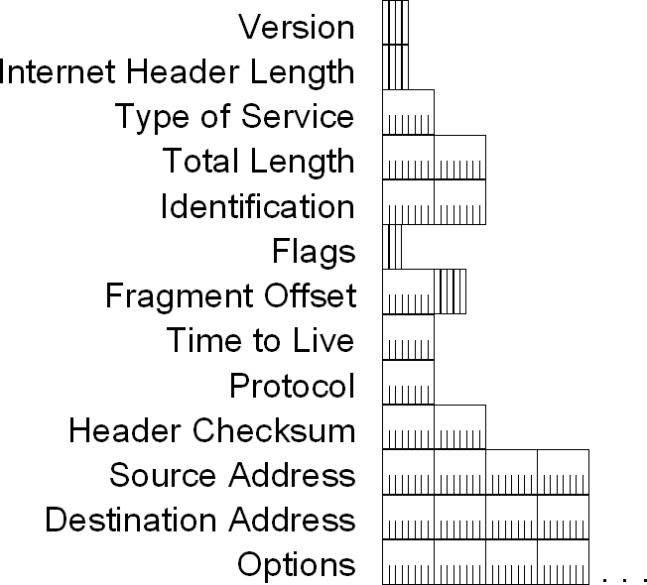
IPv4 Header - Review

Slide 10



IPv4 Header - Review
Version (4 bits)
Indicates the version of IP and is set to 4.
Internet Header Length (4 bits)
Indicates the number of 4-byte blocks in the IPv4 header.
Because an IPv4 header is a minimum of 20 bytes in size, the smallest value of the Internet Header Length (IHL) field is 5.
Type of Service (4 bits)
Indicates the desired service expected by this packet for delivery through routers across the IPv4 internetwork.

Slide 11



IPv4 Header - Review
Total Length (16 bits)
Indicates the total length of the IPv4 packet (IPv4 header + IPv4 payload) and does not include link layer framing.
Identification (16 bits)
Identifies this specific IPv4 packet.
The Identification field is selected by the originating source of the IPv4 packet. If the IPv4 packet is fragmented, all of the fragments retain the Identification field value so that the destination node can group the fragments for reassembly.
Flags (3 bits)
Identifies flags for the fragmentation process.
There are two flags—one to indicate whether the IPv4 packet might be fragmented and another to indicate whether more fragments follow the current fragment.
Fragment Offset (13 bits)
Indicates the position of the fragment relative to the original IPv4 payload.

Slide 12
IPv4 Header - Review
Time to Live ( 8 bits)
Indicate the maximum number of links on which an IPv4 packet can travel before being discarded.
Originally used as a time count with which an IPv4 router determined the length of time required (in seconds) to forward the IPv4 packet, decrementing the TTL accordingly. When the TTL equals 0,an ICMP Time Expired-TTL Expired in Transit message is sent to the source IPv4 address and the packet is discarded.
Protocol (8 bits)
Identifies the upper layer protocol.
For example, TCP uses a Protocol of 6, UDP uses a Protocol of 17, and ICMP uses a Protocol of 1.
The Protocol field is used to demultiplex an IPv4 packet to the upper layer protocol.

Slide 13
IPv4 Header - Review
Header Checksum (16 Bits)
Provides a checksum on the IPv4 header only.
The IPv4 payload is not included in the checksum calculation as the IPv4 payload and usually contains its own
checksum..
Source Address ( 32 bits)
Stores the IPv4 address of the originating host.
Destination Address (32 bits)
Stores the IPv4 address of the destination host.
Options (multiple of 32 bits)
Stores one or more IPv4 options.

Slide 14
Types of addressing
Classful Addressing
Classless Addressing

Slide 15
Classful Addressing and Problem solving

Slide 16

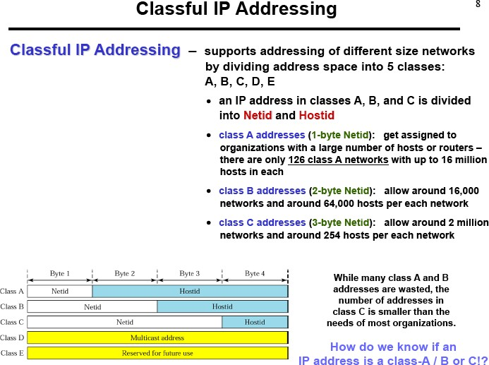

Slide 17
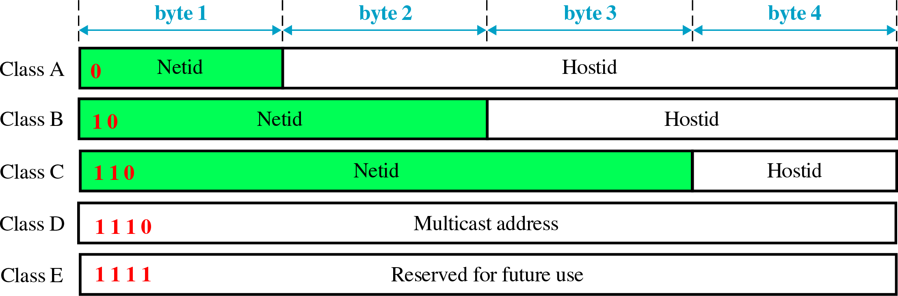
Classful Addressing
In classful addressing, the address space is divided into five classes: A, B, C, D, and E.

Slide 18
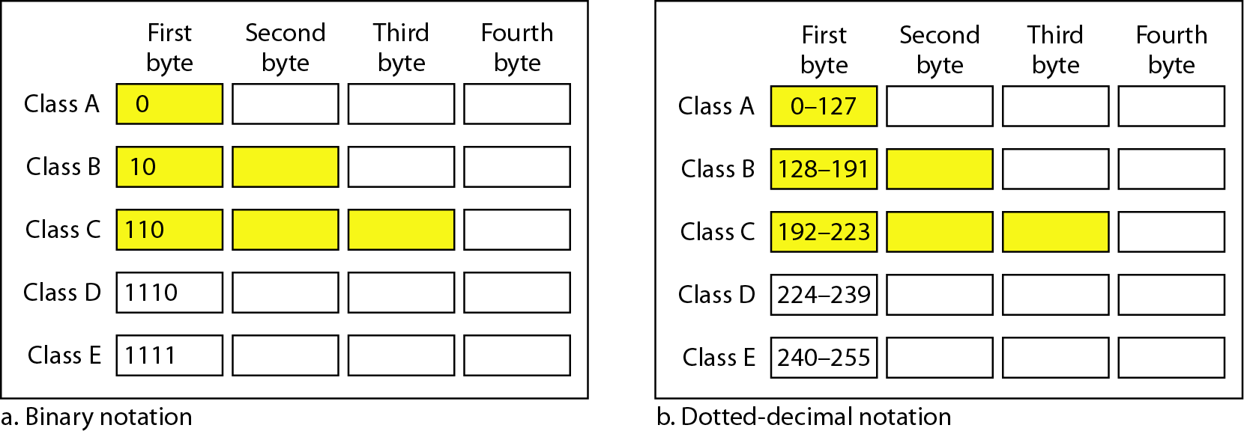
Finding the classes in binary and dotted-decimal notation

Slide 19
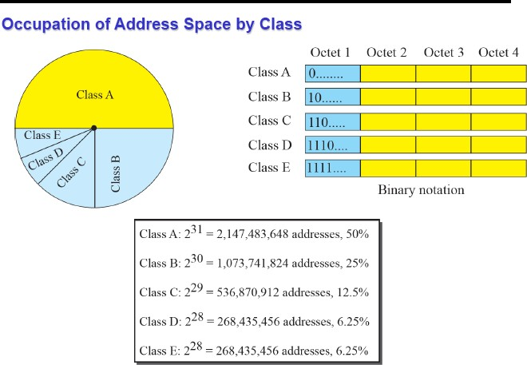
Classful Addressing

Slide 20
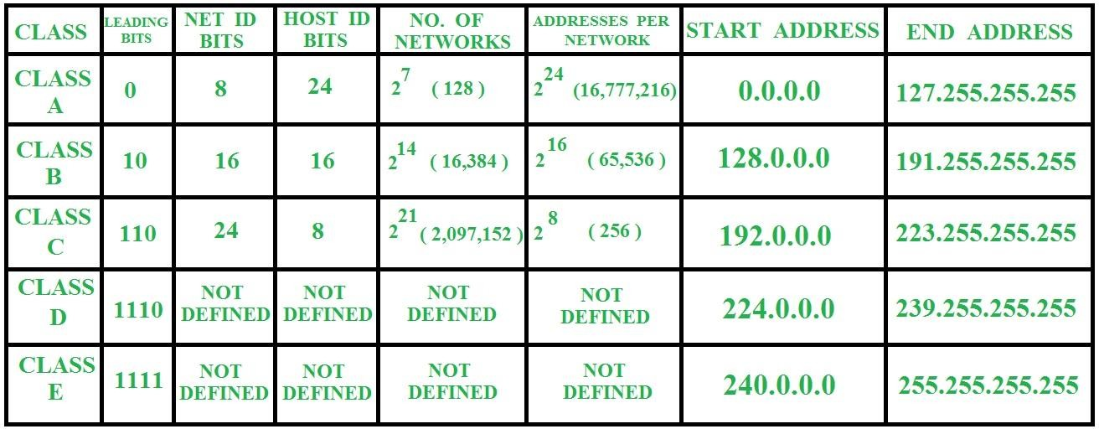
Classful Addressing – Class Range

Slide 21



Example 1
Change the following IPv4 addresses from binary notation to dotted-decimal notation.
Change the following IPv4 addresses from binary
notation to dotted-decimal notation.
Solution
We replace each group of 8 bits with its equivalent decimal number (see Appendix B) and add dots for separation.
Solution
We replace each group of 8 bits with its equivalent decimal number (see Appendix B) and add dots for separation.
19.21

Slide 22


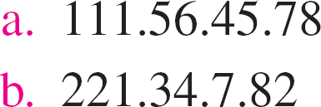
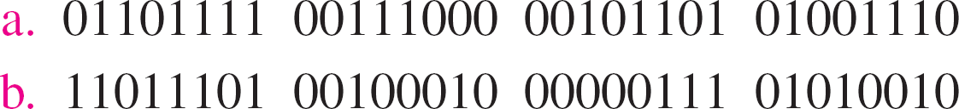
Example 2
Change the following IPv4 addresses from dotted- decimal notation to binary notation.
Solution
We replace each decimal number with its binary equivalent
19.22

Slide 23
Example 3
Find the class of each address.
a. 00000001 00001011 00001011 11101111
b. 11000001 10000011 00011011 11111111
c. 14.23.120.8
d. 252.5.15.111
Solution
The first bit is 0. This is a class A address.
The first 2 bits are 1; the third bit is 0. This is a class C
address.
The first byte is 14; the class is A.
The first byte is 252; the class is E.
19.23

Slide 24
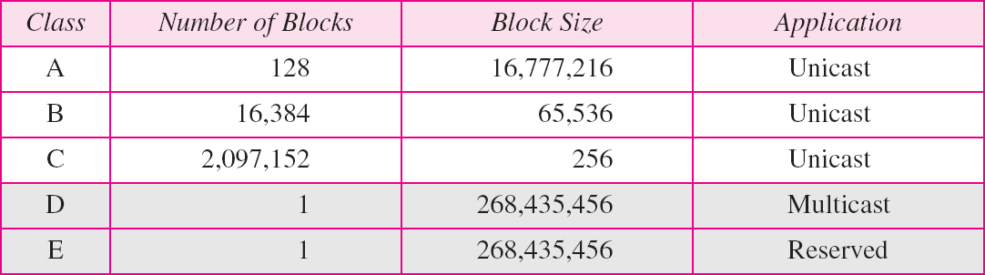
Table 1 Number of blocks and block size in classful IPv4 addressing

Slide 25

Note
In classful addressing, a large part of the available addresses were wasted.

Slide 26
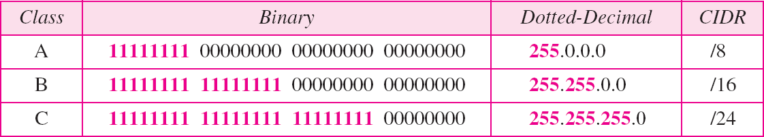
Table 2 Default masks for classful addressing

Slide 27
Note
Classful addressing, which is almost obsolete, is replaced with classless addressing.
19.27

Slide 28
Note
In IPv4 addressing, a block of addresses can be defined as
x.y.z.t /n
in which x.y.z.t defines one of the addresses and the /n defines the mask.
19.28

Slide 29
Note
The first address in the block can be found by setting the rightmost
32 − n bits to 0s.
19.29

Slide 30
Example 19.6
A block of addresses is granted to a small organization. We know that one of the addresses is 205.16.37.39/28. What is the first address in the block?
Solution
The binary representation of the given address is 11001101 00010000 00100101 00100111
If we set 32−28 rightmost bits to 0, we get
11001101 00010000 00100101 0010000
or 205.16.37.32.
This is actually the block shown in Figure 19.3.
19.30

Slide 31
Note
The last address in the block can be found by setting the rightmost
32 − n bits to 1s.
19.31

Slide 32
Example 19.7
Find the last address for the block in Example 19.6.
Solution
The binary representation of the given address is 11001101 00010000 00100101 00100111
If we set 32 − 28 rightmost bits to 1, we get 11001101 00010000 00100101 00101111
or 205.16.37.47
This is actually the block shown in Figure 19.3.
19.32

Slide 33
Note
The number of addresses in the block can be found by using the formula ₂32−n.
19.33

Slide 34
Example 19.8
Find the number of addresses in Example 19.6.
Solution
The value of n is 28, of addresses is 2 ³²⁻²⁸ or 16.
which
means
that
number
19.34

Slide 35
Example 19.9
Another way to find the first address, the last address, and the number of addresses is to represent the mask as a 32-bit binary (or 8-digit hexadecimal) number. This is particularly useful when we are writing a program to find these pieces of information. In Example 19.5 the /28 can be represented as
11111111 11111111 11111111 11110000
(twenty-eight 1s and four 0s).
Find
The first address
The last address
The number of addresses.
19.35

Slide 36
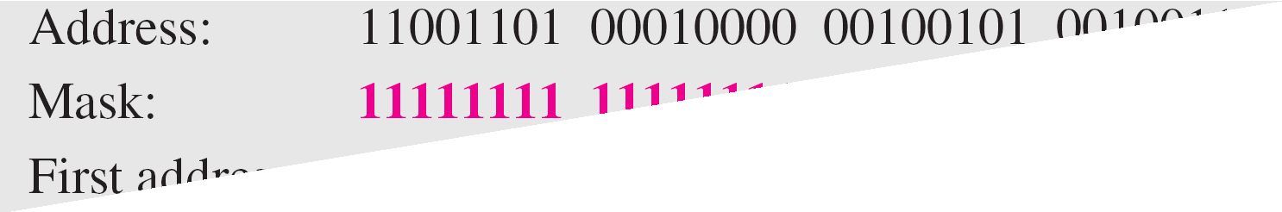
Example 19.9 (continued)
Solution
a. The first address can be found by ANDing the given addresses with the mask. ANDing here is done bit by bit. The result of ANDing 2 bits is 1 if both bits are 1s; the result is 0 otherwise.
19.36

Slide 37
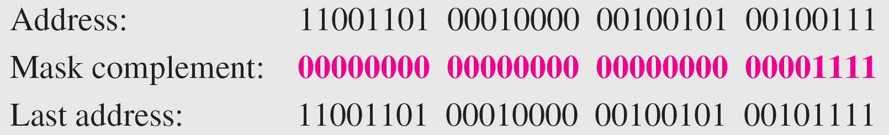
Example 19.9 (continued)
b. The last address can be found by ORing the given addresses with the complement of the mask. ORing here is done bit by bit. The result of ORing 2 bits is 0 if both bits are 0s; the result is 1 otherwise. The complement of a number is found by changing each 1 to 0 and each 0 to 1.
19.37

Slide 38
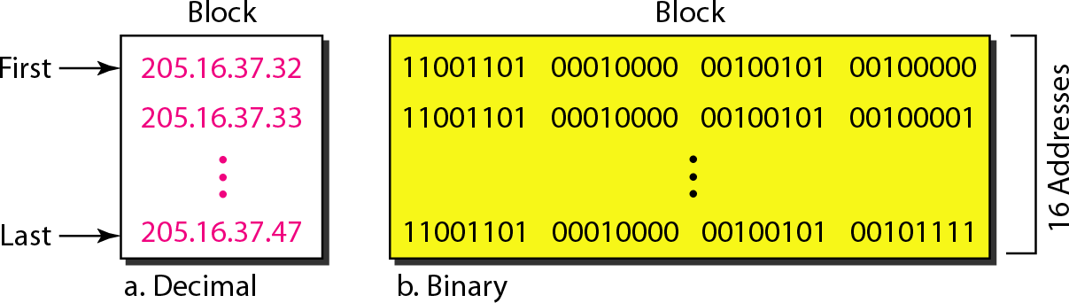
Figure 19.4 A network configuration for the block 205.16.37.32/28
19.38

Slide 39
Note
The first address in a block is normally not assigned to any device;
it is used as the network address that represents the organization
to the rest of the world.
19.39

Slide 40
Session 2
Subnet Mask Subnetting

Slide 41
Types of addressing
Classful Addressing
Classless Addressing

Slide 42
Classful Addressing and Problem solving

Slide 44
Classful Addressing
In classful addressing, the address space is divided into five classes: A, B, C, D, and E.

Slide 45
Classful Addressing

Slide 46
Classful Addressing – Class Range

Slide 47
Example 1
Change the following IPv4 addresses from binary notation to dotted-decimal notation.
Change the following IPv4 addresses from binary
notation to dotted-decimal notation.
Solution
We replace each group of 8 bits with its equivalent decimal number (see Appendix B) and add dots for separation.
Solution
We replace each group of 8 bits with its equivalent decimal number (see Appendix B) and add dots for separation.
19.47

Slide 48
Example 2
Change the following IPv4 addresses from dotted- decimal notation to binary notation.
Solution
We replace each decimal number with its binary equivalent
19.48

Slide 49
Example 3
Find the class of each address.
a. 00000001 00001011 00001011 11101111
b. 11000001 10000011 00011011 11111111
c. 14.23.120.8
d. 252.5.15.111
Solution
The first bit is 0. This is a class A address.
The first 2 bits are 1; the third bit is 0. This is a class C
address.
The first byte is 14; the class is A.
The first byte is 252; the class is E.
19.49

Slide 50
Table 1 Number of blocks and block size in classful IPv4 addressing

Slide 51
Note
In classful addressing, a large part of the available addresses were wasted.

Slide 52
Table 2 Default masks for classful addressing

Slide 53
Note
Classful addressing, which is almost obsolete, is replaced with classless addressing.

Slide 54
Note
In IPv4 addressing, a block of addresses can be defined as
x.y.z.t /n
in which x.y.z.t defines one of the addresses and the /n defines the mask.

Slide 55
Note
The first address in the block can be found by setting the rightmost
32 − n bits to 0s.

Slide 56
Example 4
A block of addresses is granted to a small organization. We know that one of the addresses is 205.16.37.39/28. What is the first address in the block?
Solution
The binary representation of the given address is 11001101 00010000 00100101 00100111
If we set 32−28 rightmost bits to 0, we get
11001101 00010000 00100101 0010000
or 205.16.37.32.

Slide 57
Note
The last address in the block can be found by setting the rightmost
32 − n bits to 1s.

Slide 58
Example 5
Find the last address for the block in 205.16.37.39/28.
Solution
The binary representation of the given address is 11001101 00010000 00100101 00100111
If we set 32 − 28 rightmost bits to 1, we get 11001101 00010000 00100101 00101111
or 205.16.37.47

Slide 59
Note
The number of addresses in the block can be found by using the formula ₂32−n.

Slide 60
Example 6
Find the number of addresses in 205.16.37.39/28.
Solution
The value of n is 28, of addresses is 2 ³²⁻²⁸ or 16.
which
means
that
number

Slide 61
Example 7
Another way to find the first address, the last address, and the number of addresses is to represent the mask as a 32-bit binary (or 8-digit hexadecimal) number. This is particularly useful when we are writing a program to find these pieces of information. In Example 19.5 the /28 can be represented as
11111111 11111111 11111111 11110000
(twenty-eight 1s and four 0s).
Find
The first address
The last address
The number of addresses.

Slide 62
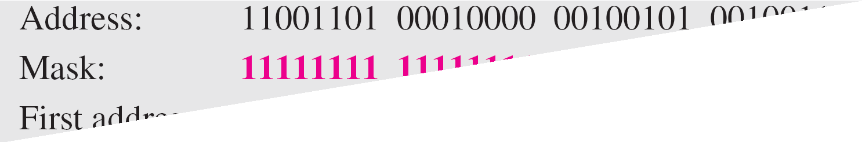
Example 7 (continued)
Solution
a. The first address can be found by ANDing the given addresses with the mask. ANDing here is done bit by bit. The result of ANDing 2 bits is 1 if both bits are 1s; the result is 0 otherwise.

Slide 63
Example 7 (continued)
b. The last address can be found by ORing the given addresses with the complement of the mask. ORing here is done bit by bit. The result of ORing 2 bits is 0 if both bits are 0s; the result is 1 otherwise. The complement of a number is found by changing each 1 to 0 and each 0 to 1.

Slide 64
Figure 1 A network configuration for the block 205.16.37.32/28

Slide 65
Note
The first address in a block is normally not assigned to any device;
it is used as the network address that represents the organization
to the rest of the world.

Slide 66
Two level hierarchy - Three level hierarchy- subnet mask - Address aggregation- problem solving.

Slide 67
Hierarchy of IPv4 Addressing
Each address in the block can be considered as a two-level hierarchical structure: the leftmost n bits (prefix) define
the network; the rightmost 32 − n bits define the host.
Why Hierarchy?
19.67

Slide 68
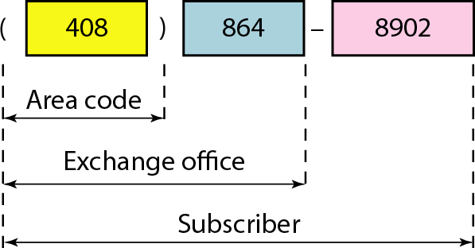
Figure 2 Two levels of hierarchy in an IPv4 address
19.68

Slide 69
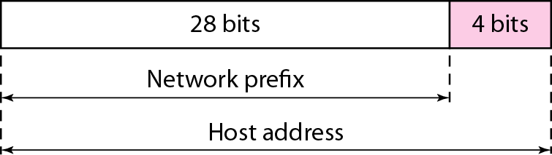
Two Level of Hierarchy
19.69

Slide 70
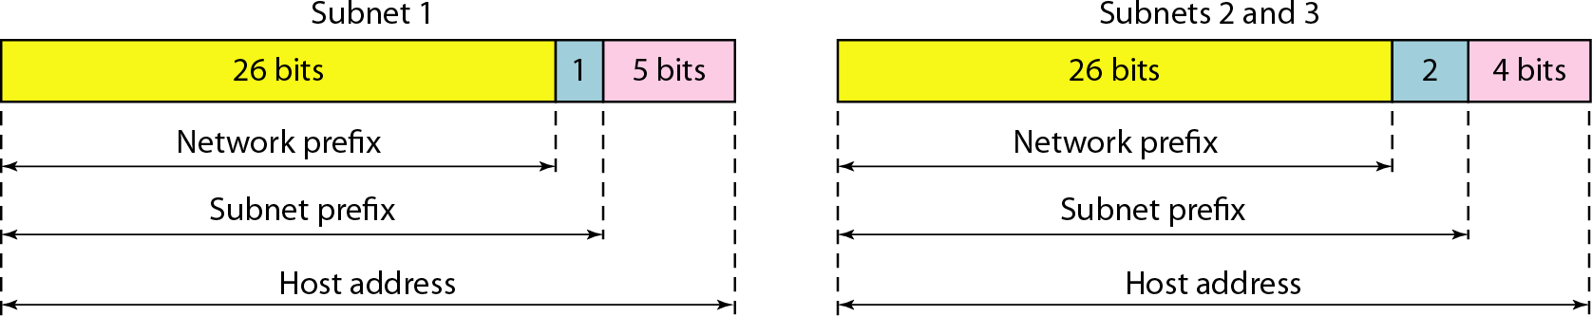
Three Level of Hierarchy
19.70

Slide 71
Address Aggregation
IP Address Aggregator is a utility developed to automate minimization process and convert bunch of IPv4 addresses into smallest continuous range(s) possible. IP aggregation is commonly performed by network engineers working with BGP & routers.
This utility will help webmasters to configure server firewalls, apache, address masks and so on.

Slide 72
Session 5
Special Addresses
72

Slide 73

Special Addresses
An IP address (internet protocol address) is a numerical representation that uniquely identifies a specific interface on the network.
Addresses in IPv4 are 32-bits long. This allows for a maximum of 4,294,967,296 (2³²) unique addresses. Addresses in IPv6 are 128-bits, which allows for 3.4 x 10³⁸ (2¹²⁸) unique addresses.
The total usable address pool of both versions is reduced by various reserved addresses and other considerations.
IP addresses are binary numbers but are typically expressed in decimal form (IPv4) or hexadecimal form (IPv6) to make reading and using them easier for humans.
2 February 2023

Slide 74
Special Addresses
There are a few reserved IPv4 address spaces which cannot be used on the internet. These addresses serve special purpose and cannot be routed outside the Local Area Network.
As in Classful IP Addressing, some blocks of addresses or some addresses in each block have been reserved for the special purpose & that’s why they are termed as special IP addresses.
The special addresses of classful addressing were inherited by the classless addressing when it was introduced in 1996.
There can be an entire block of addresses reserved for special addressing or there can be some addresses in each block that are reserved for special addressing.
2 February 2023

Slide 75
Special Addresses
1. Special Blocks of Addresses
There are some blocks of addresses in IPv4 address space that are
reserved for a special objective.
The special blocks of addresses are listed below:
All Zeros Address
All Ones Address
Loopback Addresses
Private Addresses
Multicast Addresses
2 February 2023

Slide 76
Special Addresses
a)All Zeros Address
The all-zeros address block 0.0.0.0/32 is a special block in Ipv4 address space.
The length of the prefix here is 32. The number of addresses in this block is equal to 2³²⁻³² = 2⁰ = 1. So, this block has only one address with all the 32 bits as zero. This address is the first address in the IPv4 address space.
Any host having this IP address means the host is not connected to the TC/IP network. When the host wants to get connected to the internet, it sends a request packet to the bootstrap server which is also called a DHCP server.
The packet sent by the host to DHCP server has source address as 0.0.0.0 and
225.225.225.225 as the destination address.
The DHCP server then assigns the IP address to the host and host then get
connected to the Internet.
2 February 2023

Slide 77
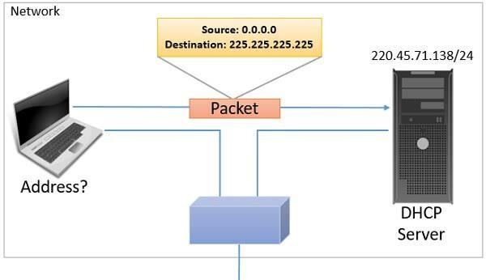
Special Addresses
a)All Zeros Address
2 February 2023

Slide 78
Special Addresses
b) All One Address
The block 225.225.225.225/32 is also a special block in IPv4 address space.
Here, all the 32 bits of IPv4 address is ‘1‘. The length of the prefix here is 32.
The number of addresses in this special block can be calculated as 2³²⁻³² = 2⁰ = 1.
This is the last address in IPv4 address space. This address is also called Limited Broadcast Address we will see the reason why it is a limited broadcast address.
If a host wants to send the message to every other host in the current network, which means the host wants to broadcast a message in the current network. Then the host uses this address as the destination address in the IPv4 packet and sends it on the network.
But, whenever the router finds the IPv4 packets with 225.225.225.225 as the destination address, it restricts the packet to be broadcasted in the local network only. Hence, it is called a limited broadcast address as it limits the packet
2 February 2023 _{to be broadcasted in}1_{t}8_{h}C_{e}SS2_{lo}02_{c}J_{a}C_{l}o_{n}m_{e}p_{t}u_{w}ter_{o}C_{r}o_{k}m_{o}m_{n}un_{ly}ic.ations - Unit 2, Session 5
78

Slide 79
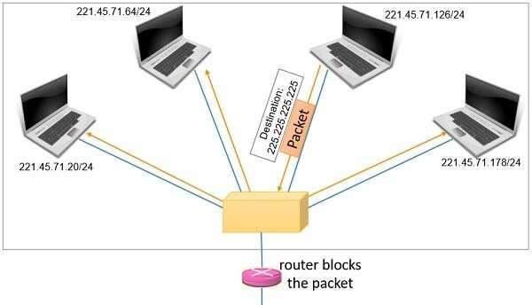
Special Addresses
b) All One Address
2 February 2023

Slide 80
Special Addresses
c) Loopback Addresses
The special block 127.0.0.0/8 has addresses which are used as loopback addresses. Now, the prefix length here is 8 so, the number of addresses can be
₌ ₂24
calculated as 2³²⁻⁸ = 1,67,77,216. This special block has 1,67,77,216
addresses. If we consider this address in classful addressing, then this block is the last block of class A.
All the addresses starting with 127. should be considered as loopback addresses. The loopback address can only be the destination address of a packet. The packet with loopback address never leaves the machine from which it is sent, it just returns back to the source.
2 February 2023
18CSS202J Computer Communications - Unit 2, Session 5

Slide 81
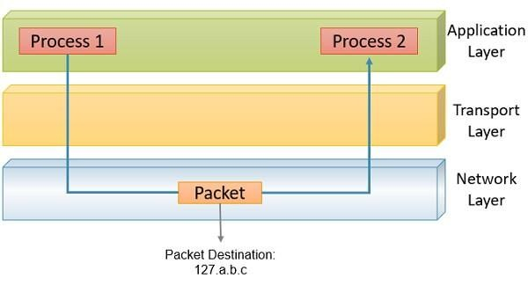
Special Addresses
c) Loopback Addresses
For example, it can be used to check whether the NIC is properly functioning or not. To check the network application on the system. Out of 1,67,77,216 loopback addresses only 127.0.0.1 is used rest 1,67,77,215 addresses are just total wastage of addresses.
2 February 2023
18CSS202J Computer Communications - Unit 2, Session 5

Slide 82
Special Addresses
d) Private Addresses
The private IP addresses are never used globally. The packet with a private IP address is not routed on the internet.
The private IP addresses are configured by the administrator of the network.
Devices on the same network use private IP addresses to converse with each
other.
They do not require the internet for their communication. Like, the file servers, desktops and printers can communicate with each other without the requirement of internet.
But, when they want to communicate with the device out of their network they translate a private IP address into the public IP address using NAT.
2 February 2023
18CSS202J Computer Communications - Unit 2, Session 5

Slide 83
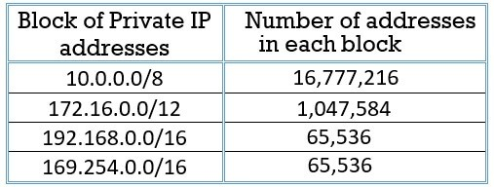
Special Addresses
d) Private Addresses
The range of private IP addresses is given below:
2 February 2023
18CSS202J Computer Communications - Unit 2, Session 5

Slide 84
Special Addresses
e) Multicast Addresses
The block 224.0.0.0/4 has the multicast address. The length of the prefix is 4.
The number of addresses used for multicast communication is
2³²⁻⁴ = 2²⁸ = 26,84,35,456.
The multicast address is assigned to the group of the host instead of one single
host.
The packet sent to the multicast address is delivered to all the host of that group.
2 February 2023
18CSS202J Computer Communications - Unit 2, Session 5

Slide 85
Special Addresses
2. Special IP Addresses in Each Block
There are two special addresses which are in each block: a)Network Address
b)Direct Broadcast Address
2 February 2023
18CSS202J Computer Communications - Unit 2, Session 5

Slide 86
Special Addresses
a) Network Address
In classful and classless addressing the first address of the block is the network address itself.
The first address of the block has all the suffix bits as ‘0’.
The network address is not allocated to any of the hosts in the network.
If the block has been subnetted and the network has been divided into subnetwork then the first address of subnetwork will play the same role as the network address. The first address of the subnetwork is also termed as subnetwork address and this subnetwork address will not be assigned to any host in the subnetwork.
In case the assigned block is too small then it is not possible to consider some
2 February 2023of the addresses in th1e8CbSSl2o0c2kJ Caoms psupteercCioaml madundicraetisosns. - Unit 2, Session 5
86

Slide 87
Special Addresses
b) Direct Broadcast Address
As first address in the block is reserved as the network address.
The last address of the block is reserved as a direct broadcast address.
The direct-broadcast address has all its suffix bits as ‘1’.
Whenever the router obtains the IPv4 packet with a destination address who’s all suffix bits are 1 it broadcast that packet to all the host in the specific network.
Direct broadcast address will always be used as the destination address in IPv4
packet.
2 February 2023
18CSS202J Computer Communications - Unit 2, Session 5

Slide 88
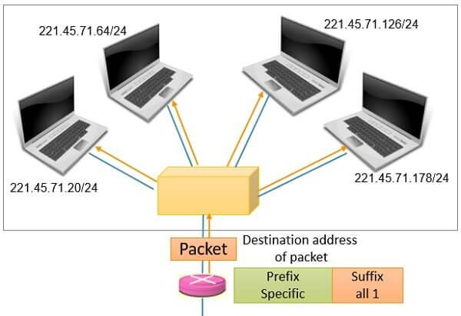
Special Addresses
b) Direct Broadcast Address
This is about the special addresses and special blocks of addresses.
2 February 2023
18CSS202J Computer Communications - Unit 2, Session 5

Slide 89
Session 6
Classless Addressing
Problem Solving
89

Slide 90
Classless Addressing
To overcome organizations
address depletion and give more access to the Internet, classless
addressing was designed and implemented.
90

Slide 91
Classless Addressing
Address Blocks
In classless addressing, when an entity, small or large, needs to be connected to the
granted a BLOCK
ADDRESSES.
The size of the block (the number of addresses) varies based on the nature and size of the entity.
For example:
A household → only two addresses
A large organization → given thousands of addresses.
An ISP, as the Internet service provider → given thousands or hundreds of thousands based on the number of customers it may serve.
Internet, it is
(RANGE) OF
91

Slide 92
Classless Addressing - Restriction
To simplify the handling of addresses, the Internet authorities impose three restrictions
on classless address blocks:
Addresses in a block must be contiguous, one after another.
Number of addresses in a block must be a power of 2 (I, 2, 4, 8, ... ).
First address must be evenly divisible by the number of addresses.
92

Slide 93





Slash Notation
Slash notation is also called
CIDR (Classless inter-domain routing) notation.
Exampl e
The beginning address is 205.16.37.24. To find the last address we keep the first 29 bits and change the last 3 bits to 1s.
Beginning:11001111 00010000 00100101
00011000
Ending : 11001111 00010000 00100101
A small
organization is given a
block with the
beginning
address and the
205.16.37.24/29
notation).
prefix length
(in slash
What is the range of the block?
00011111
There are only 8 addresses in this block.
We can argue that the length of the suffix is 32 − 29 or 3. So there are 2³ = 8 addresses in this block. If the first address is 205.16.37.24, the last address is 205.16.37.31 (24 + 7 = 31).
93
93

Slide 94

Slash Notation
A block in classes A, B, and C can easily be represented in slash notation as A.B.C.D/ n
where n is either 8 (class A), 16 (class B), or 24 (class C).
What is the network address if one of the addresses is 167.199.170.82/27
The prefix length is 27, which means that we must keep the first 27 bits as is and change the remaining bits (5) to 0s.
The 5 bits affect only the last byte. The last byte is 01010010. Changing the last 5 bits to 0s, we get 01000000 or 64.
The network address is 167.199.170.64/27.

Slide 95
Problem Solving
An ISP is granted a block of addresses starting with 190.100.0.0/16. The ISP
needs to distribute these addresses to three groups of customers as follows:
The first group has 64 customers; each needs 256 addresses.
The second group has 128 customers; each needs 128 addresses.
The third group has 128 customers; each needs 64 addresses.
Design the sub blocks and give the slash notation for each sub block.
Find out how many addresses are still available after these allocations?

Slide 96


Solution
Group 1
For this group, each customer needs 256 addresses. This means the suffix length is 8 (2⁸ = 256).
The prefix length is then 32 - 8 = 24.
01: 190.100.0.0/24 ➔190.100.0.255/24
02: 190.100.1.0/24 ➔190.100.1.255/24
…………………………………..
64: 190.100.63.0/24➔190.100.63.255/24
Total = 64 × 256 = 16,384
Group 2
For this group, each customer needs 128
addresses. This means the suffix length is 7 (2⁷
= 128).
The prefix length is then 32 − 7 = 25. The addresses are:
001: 190.100.64.0/25 ➔190.100.64.127/25
002: 190.100.64.128/25 ➔190.100.64.255/25
003:190.100.127.128/25
➔190.100.127.255/25
Total = 128 × 128 = 16,384

Slide 97


Solution
Group 3
For this group, each customer needs 64 addresses.
This means the suffix length is 6 (26 = 64).
The prefix length is then 32 - 6 = 26. 001:190.100.128.0/26 ➔190.100.128.63/26
002:190.100.128.64/26 ➔190.100.128.127/26
…………………………
128:190.100.159.192/26 ➔190.100.159.255/26
Total = 128 × 64 = 8,192
Number of granted addresses: 65,536
Number of allocated addresses: 40,960 Number of available addresses: 24,576

Slide 98
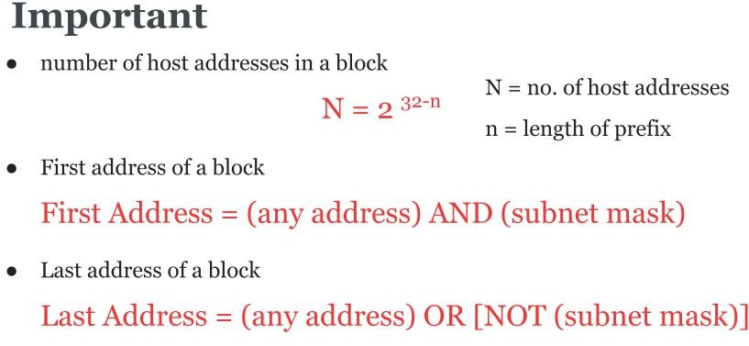

Slide 99
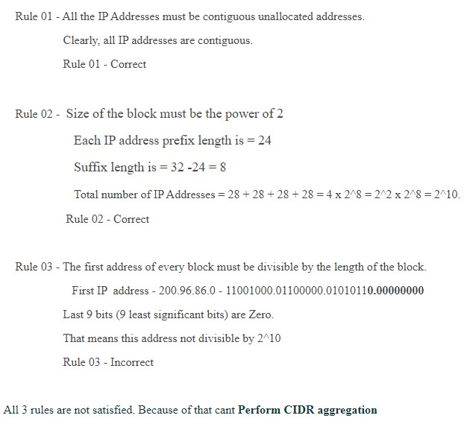
Problem Solving
Perform CIDR aggregation on the following IP Addresses- 200.96.86.0/24
200.96.87.0/24
200.96.88.0/24
200.96.89.0/24
Solutio n

Slide 100
Intermediate devices - Hub, Repeaters and Switch

Slide 101
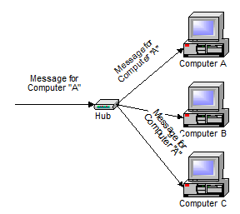
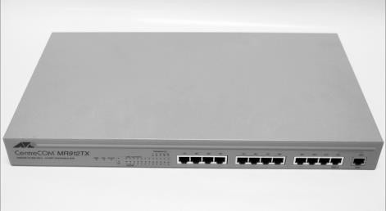
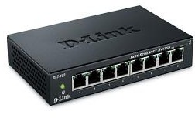
Intermediate devices - Hubs
A hub is typically the least expensive, least intelligent, and least complicated. Its job is very simple – anything that comes in one port is sent out to the others. That is it broadcasts everything.
If a message comes in for computer “A”, that message is sent out all the other ports, regardless of which one computer “A” is on:
M.RAJALAKSHMI

Slide 102
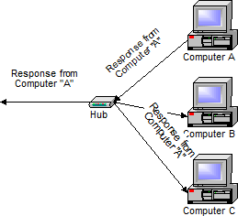
Hubs
And when computer “A” responds, its response also goes out to every other port on the hub:
Every computer connected to the hub “sees” everything that every other computer on the hub sees. The computers themselves decide if they are the targeted recipient of the message and when a message should be paid attention to or not.
M.RAJALAKSHMI

Slide 103
Types of Hub
Active Hub:- These are the hubs which have their own power supply and can clean, boost and relay the signal along with the network. It serves both as a repeater as well as wiring centre. These are used to extend the maximum distance between nodes.
Passive Hub :- These are the hubs which collect wiring from nodes and power supply from active hub. These hubs relay signals onto the network without cleaning and boosting them and can’t be used to extend the distance between nodes.
M.RAJALAKSHMI

Slide 104
Drawbacks
Hubs cannot filter data, so data packets are sent to all connected devices.
They do not have intelligence to find out best path for data packets which leads to inefficiencies and wastage.
M.RAJALAKSHMI

Slide 105
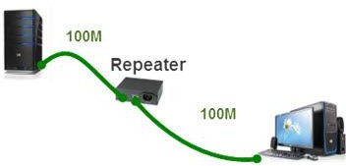
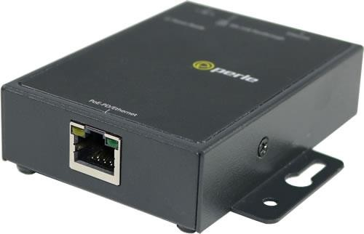
Repeaters
Ethernet Repeaters
A repeater operates at the physical layer.
Its job is to regenerate the signal over the same network before the signal becomes too weak or corrupted so as to extend the length to which the signal can be transmitted over the same network.
They do not amplify the signal. When the signal becomes weak, they copy the signal bit by bit and regenerate it at the original strength.
It is a 2 port device.
Because the functionality of repeaters has been built in to other devices, such as hubs and switches, repeaters are rarely used.
M.RAJALAKSHMI

Slide 106
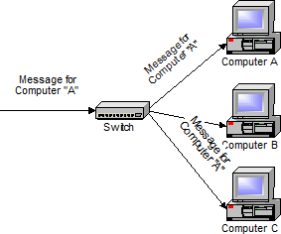
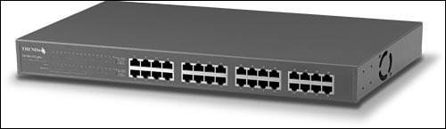
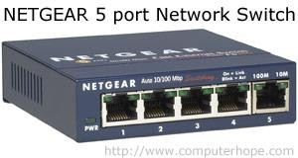
Switches
A switch does essentially what a hub does, but more efficiently.
By paying attention to the traffic that comes across it, it can
“learn” where particular addresses are.
Initially, a switch knows nothing and simply sends on incoming
messages to all ports:
A 32-port Ethernet switch.

Slide 107
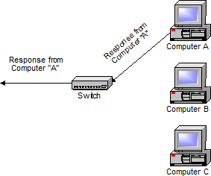
Switches
Even accepting that first message, however, the switch has learned something – it knows on which connection the sender of the message is located.
Thus, when machine “A” responds to the message, the switches
only need to send that message out to the one connection:

Slide 108
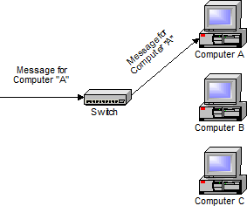
Switches
In addition to sending the response through to the originator, the switch has now learned something else – it now knows on which connection machine “A” is located.
That means that subsequent messages destined for machine “A” need only be sent to that one port:

Slide 109
Switches
Switches learn the location of the devices that they are connected
to almost instantaneously.
A switch is a data link layer device.
The switch can perform error checking before forwarding data, that makes it very efficient as it does not forward packets that have errors and forward good packets selectively to correct port only.
The net result is that most network traffic only goes where it needs to rather than to every port.
On busy networks, this can make the network significantly faster.

Slide 110
1. Which one of the following network devices connects two networks?
Bridge
Hub
Repeater
Gateway ANS: Gateway
2. Which one of the following network devices works on the data link layer of an OSI model?
Hub
Switch
Router
Gateway ANS: Switch

Slide 111
3. Which one of the following network devices is used to connect different networks?
Hub
Switch
Router
Gateway ANS: Router
4. Which one of the following network devices is the broadcast device?
Hub
Router
Switch
Bridge
ANS: Hub

Slide 112
5. Which one of the following network devices is used to create a network?
Hub
Switch
Router
Gateway ANS: Switch
6. Which one of the following network devices works on the physical layer of an OSI model?
Hub
Switch
Router
Gateway
ANS: Hub

Slide 113
7. Which one of the following network devices is not an intelligent device?
Hub
Switch
Router
Gateway ANS: Hub
8. Which one of the following network devices uses bits or electrical signals to send the data?
Hub
Switch
Router
Gateway ANS: Hub

Slide 114
9. Which one of the following network devices divides the network to reduce the traffic?
Hub
Switch
Bridge
Router ANS: Bridge
10. Which one of the following network devices reads frames to send the data?
Hub
Switch
Router
Gateway ANS: Switch

Slide 115
Questions
Mention the function of hub.
Demonstrate the working principles of Hub and Switch.
Discuss the working principles of Repeater.
Classify the functions of Bridges & Switches in brief.
What are the functions of bridges?
Name the four basic network topologies and explain them giving all the relevant features.
Distinguish between point to point links and multi point links. Give relevant diagrams
Discuss various types of networks topologies in computer network.

Slide 116
Bridges Structure of router

Slide 117
2.10.1 What is a Bridge in a Computer Network?
Definition1:
A bridge is one of the network devices in computer networks to connect two or more communication networks or network segments and creates a single network. It provides interconnection with other computer networks, which use the same protocol. The multiple local area networks (LANs) can be connected to form a larger local area network.
Definition2:
A bridge in a computer network is one kind of network device, used to separate a network into sections. Every section in the network represents a collision domain that has separate bandwidth. So that network performance can be improved using a bridge. In the OSI model, a bridge works at layer-2 namely the data link layer. The main function of this is to examine the incoming traffic and examine whether to filter it or forward it.

Slide 118
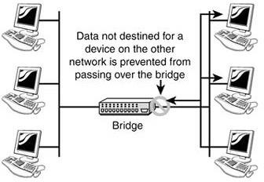
2.10.2 Working Principle
In a computer network, a bridge separates a LAN into different segments like segment1 & segment2, etc and the MAC address of all the PCs can be stored into the table.
For instance, PC1 transmits the data to PC2, where the data will transmit to the bridge first.
So the bridge reads the MAC address & decides whether to transmit the data to segment1 or segment2.
Therefore, the PC2 is accessible in segment1, which means the bridge transmits the data in segment1 only & eliminates all the connected PCs in segment2.
In this way, the bridge reduces traffic
in a computer network.

Slide 119
2.10.3 Functions of Bridges in Computer Network
The bridge allows to spit the local area network into many small
segments.
It performs the all tasks in data link layer in OSI model.
Bridge helps to hold the MAC address of all computers in the network.
It helps to decrease the traffic over the network.
With using of MAC address, bridge gets to filter the all contents of source and destination points.
It is used for making the interconnection two LAN networks along with
single and same protocol.
Bridge can work as single large LAN with connecting the multiple virtual LANs.
Bridge has ability to switch any types of data packets like as Apple talk packets or IP packets over the network layer because in which payload field of the data frame is not considered. Only MAC address or destination address of the frame is acceptable to block or forward the data to each node in the computer network.

Slide 120
2.10.4 Types of Bridges
Bridges in the computer network are classified into five types which
include the following.
Transparent Bridge.
Translational Bridge.
Source-route Bridge.
MAC-Layer Bridge.
Remote Type Bridge

Slide 121
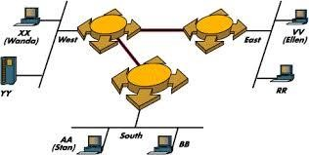
2.10.4 .1 Transparent Bridge
It is also known as the “Learning Bridges“.
Transparent bridge has not visibility to other installed stations or
terminals over the computer network.
It does not need to reconfigure the station because it is either added or deleted from the entire network.
Main aim of the transparent bridge is getting to block or
forwarding the data packets depend on the MAC address.
It is getting more popularity while using in the networking.
Transparent bridge is a plug and play bridge.
This bridge creates its table of terminal addresses on its own.
It allows to make its table for source location and able to self updating.

Slide 122
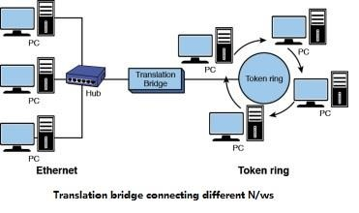
2.10.4.2 Translational Bridge
A translational bridge plays a key role in changing a networking
system from one type to another.
These bridges are used to connect two different networks like token ring & Ethernet.
This bridge can add or remove the data based on the traveling direction, and forward the frames of the data link layer in between LANs which uses various types of network protocols.
The different network connections are Ethernet to FDDI/token ring otherwise Ethernet on UTP (unshielded twisted pair) to coax & in between FOC and copper wiring.

Slide 123
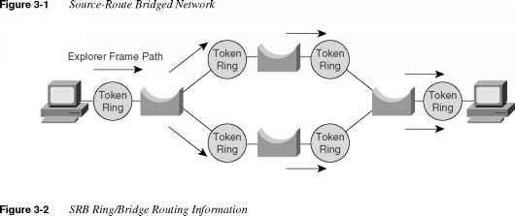
2.10.4.3 Source-route Bridge
Source-route bridge is introduced by IBM for using the Token ring networks.
It allows to embed the all frame routes into one frame, and then this bridge takes the precise decisions that how the frame is forwarding with using of the network.
In this technique, two same network segments can be linked to data link layer.
Special frames are discovered by the host, it is known as the
“Discovery Frame“, and it spreads them over the entire network.
Source-route Bridge helps to prevent the looping problems.

Slide 124
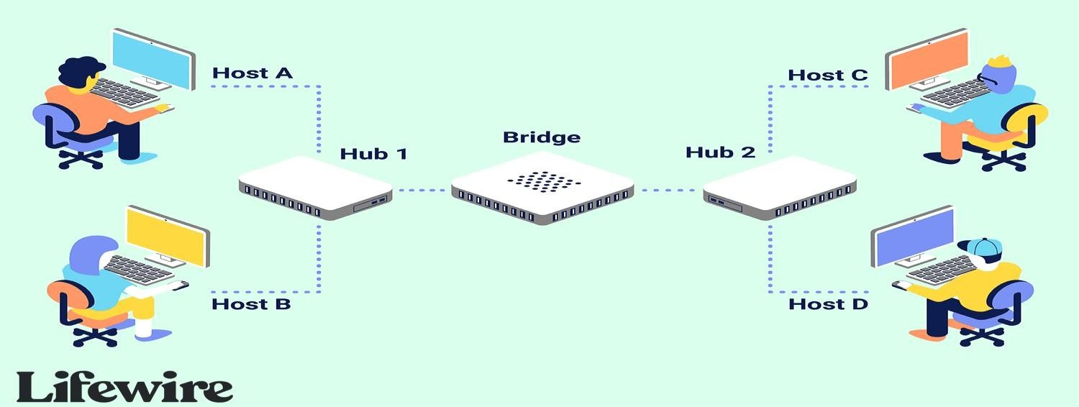
2.10.4.4 MAC-Layer Bridge
MAC-layer Bridge is also known as the “Local Bridge“
It offers the packet filtering and repeating services for network segments of the similar types.
It does not require the packet filtering or buffering because it simply broadcast the incoming data packets to the accurate port or remove them.

Slide 125
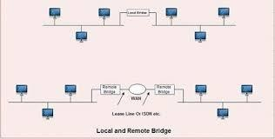
2.10.4.5 Remote Type Bridge
Remote Bridge allows to make connection two networks at different locations with using of WAN link like as MODEM or Leased Line.
Its speed can be varied depend on the local and wide area links.
This bridge has internal buffer to store the data received from LAN while it is waiting for transmission to the remote site.

Slide 126
2.10.5.1 Advantages of Bridges
Bridges are simple and significant.
They prevent unnecessary traffic from network segments.
crossing onto other
Bridge can reduce the amount of network traffic on segments.
It also make it possible to isolate a busy network from not-so-busy network.
They can connect different network architectures like Ethernet & Token ring.
Bridge have ability to look at the physical destination address of the frame and send the frame at the specific port.
Bridge can filter the traffic, it increases throughput on a network.
Connects different segments of network transmission

Slide 127
2.10.5.2 Disadvantages of Bridges
It is unable to read specific IP addresses because they are more troubled with the MAC addresses.
They cannot help while building the network between the different architectures of networks.
It transfers all kinds of broadcast messages, so they are incapable to stop the scope of messages.
It doesn’t handle more variable & complex data load which occurs from WAN.
The speed of the network is slow when compared to the repeater due to the frame buffering and relays.

Slide 128
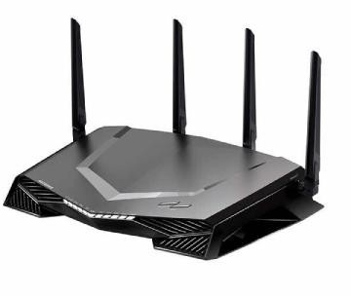
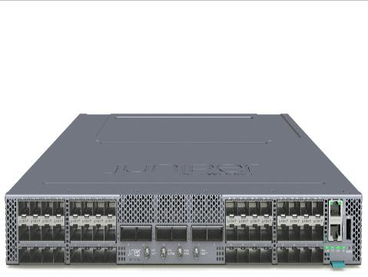
2.10.6 What is a Router?
The router is a physical internetworking device that is receive, analyze, and forward between computer networks.
or virtual designed to data packets
A router examines a destination IP address of a given data packet, and it uses the headers and forwarding tables to decide the best way to transfer the packets.
A router is used in LAN (Local Area Network) and WAN (Wide Area Network) environments.
It shares information with other routers in networking.
It uses the routing protocol to transfer the data across a network.
It is more expensive than other networking
devices like switches and hubs.

Slide 129
2.10.7 Features of Router
A router works on the Network Layer of the OSI model, and it is able to communicate with its adjacent devices with the help of IP addresses and subnet.
A router provides high-speed internet connectivity with the different
types of ports like gigabit, fast-Ethernet, and STM link port.
It allows the users to configure the port as per their requirements in the network.
Routers main components are central processing unit (CPU), flash memory, RAM, Non-Volatile RAM, console, network, and interface card.
Routers are capable of routing the traffic in a large networking system by considering the sub-network as an intact network.
Routers filter out the unwanted interference, as well as carry out the data encapsulation and DEcapsulation process.
Routers provide the redundancy as it always works in master and slave
mode.
It allows the users to connect several LAN and WAN.
Furthermore, a router creates various paths to forward the data.

Slide 130
2.10.8 Types of Routers
There are various types of routers in networking are
Wireless Router: generating a wireless signal range between 150 to 300
feet.
Brouter: A brouter is a combination of the bridge and a router.
Core router: the backbone of networks also provides various types of fast and powerful data communication interfaces.
Edge router: lower-capacity device uses an External BGP (Border Gateway Protocol) to provides connectivity with remote networks over the internet.
Subscriber edge router belongs to an end-user organization and acts on a border device.
label edge router is boundary of Multiprotocol Label Switching (MPLS)
networks and acts as a gateway between the LAN, WAN, or the internet.
Broadband routers: To provide high-speed internet through phone and use Voice Over IP technology (VOIP) access to computers.

Slide 131
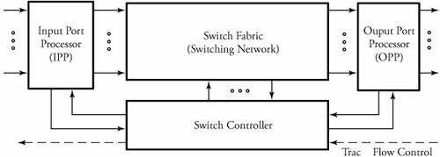
2.10.9 Router Structure
Routers are the building blocks of wide area networks.
Packets arrive at n input ports and are routed out from n output ports.
The system consists of four main parts :
input port processors
output port processors
Switch fabric (switching network)
Switch controller .

Slide 132
2.10.9.1 Input Port Processor (IPP)
Input and output port processors, as interfaces to switch fabric, are commercially implemented together in router line cards contain some of the task of the physical and data link layers .
The functionality of the data link layer is implemented as a separate chip in IPP that also provides a buffer to match the speed between the input and the switch fabric.
Switch performance is limited by processing capability, storage elements, and bus bandwidth.
The processing capability dictates the maximum rate of the switch.
Due to the speed mismatch between the rate at which a packet arrives on the switch and the processing speed of the switch fabric, input packet rate dictates the amount of required buffering storage.
The bus bandwidth determines the time taken for a packet to be
transferred between the input and output ports.

Slide 133
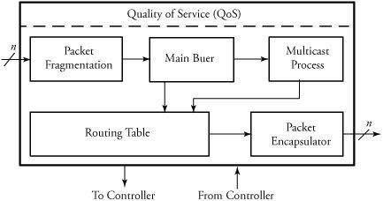
Overview of a typical IPP in routers
An input port processor (IPP) consists of several main modules are packet fragmentation , main buffer , multicast process , routing table , packet encapsulator , and a comprehensive QoS .

Slide 134

Packet Fragmentation
Large packets cause different issues at the network and link layers.
One application is large packets must be fragmented into smaller frames.
Another example when large packets must be buffered at the input port
interface of a router, as buffer slots are usually only 512 bytes long.
One solution to this problem is to partition packets into smaller fragments and then reassemble them at the output port processor (OPP) after processing them in the switching system.
simple packet fragmentation at the input buffer side of a switch.
It is always desirable to find the optimum packet size that minimizes the delay.
Packet fragmentation: (a) without fragmentation; (b) with fragmentation

Slide 135
Routing Table
It is a look-up table containing all available destination addresses and
the corresponding switch output port.
An external algorithm fills this routing lookup table.
The purpose of the routing table is to look up an entry corresponding to the destination address of the incoming packet and to provide the output network port.
As soon as a routing decision is made, all the information should be saved on the routing table.
When a packet enters an IPP, the destination port of the switch should be
chosen based on the destination address of the incoming packet.
This destination port needs to be appended to the incoming packet as part of the switch header.
To increase memory performance, queue sizes are fixed to reduce control logic.
packets can arrive and leave the network in different order, a memory monitor is necessary to keep track of which locations in memory are free for use.

Slide 136

Routing Table
example of routing tables at routers between hosts A and B. Assume that host B's address is requested by a packet with destination address 182.15.0.0/22 arriving at router 1. The routing table of this router stores the best-possible path for each destination. Assume that for a given time, this destination is found in entry row 5. The routing table then indicates that port 2 of the router is the right output to go. The table makes the routing decision, based on the estimated cost of the link, which is also stated in the corresponding entry. When the packet arrives at router 2, this switch performs the same procedure.

Slide 137
Multicast Process
It is necessary for copying packets when multiple copies of a
packet are expected to be made on a switching node.
Using a memory module for storage, copying is done efficiently.
The copying function can easily be achieved by appending a counter field to memory locations to signify the needed number of copies of that location.
The memory module is used to store packets and then duplicate multicast packets by holding memory until all instances of the multicast packet have exited IPP.
Writing to memory takes two passes for a multicast packet and only one pass for a unicast packet.
In order to keep track of how many copies a multicast packet needs, the packet counter in the memory module must be augmented after the multicast packet has been written to memory.
Each entry in the memory module consists of a valid bit, a counter value, and memory data.

Slide 138
Packet Encapsulation
It performs the routing table lookups and inserts the switch output port number into the network header.
The serial-to-parallel multiplexing unit converts an incoming serial byte stream into a fully parallel data stream.
This unit also processes the incoming IP header to determine whether the packet is unicast or multicast and extracts the type-of- service field.
Once the full packet is received, it is stored into memory.
The packet encapsulation unit formats the incoming packet with a header before forwarding the packet to the crossbar.

Slide 139
Congestion Controller
This module shields the switching node from any disorders in the traffic flow.
Congestion can be controlled in several ways.
Sending a reverse-warning packet to the upstream node to avoid exceeding traffic is one common technology installed in the structure of advanced switching systems.
Realistically, spacing between incoming packets is irregular.

Slide 140
2.10.9.2 Switch Fabric
In this module packets are routed from input ports to the desired
output ports.
A packet can also be multicast to more than one output.
Finally, in the output port processors, packets are buffered and resequenced in order to avoid packet misordering.
In addition, a number of other important processes and functions taken place in each of the mentioned blocks.
The following example shows, this model can work for ATM technology: Cells (packets) arrive at n input ports and are routed out from n output ports.
When a cell carrying VCI b arrives from a given link i, the cell's VCI is used to index a virtual-circuit translation table (VXT) in the corresponding input port processor to identify the output link address j and a new VCI c .
In the switching network, cells are routed to the desired outputs.

Slide 141

Interaction between an IPP and its switch fabric in a
virtual-circuit switching router

Slide 142
2.10.9.3 Switch Controller
The controller part of a switching system makes decisions leading to the
transmission of packets to the requested output(s).
The details of the controller are illustrated in Figure.
The controller receives packets from an IPP, but only the headers of packets are processed in the controller.
Header Decoder Unit
first converts the control information of an arriving packet into an initial requested output vector.
This bit vector carries the information pertaining to the replication of a packet so that any bit of 1 represents a request for one of the corresponding switch outputs.
Buffer Control Unit
generates a priority value for each packet to enable it for arbitration.
This information, along with the request vector, enters an array of arbitration elements in the contention resolution unit.

Slide 143
Contention Resolution Unit.
Each packet in one column of an arbitration array contends with other packets on a shared bus to access the switch output associated with that column.
After a packet wins the contention, its identity (buffer index number) is transmitted out to an OPP.
buffer-control bit transferred to the switching fabric (network), signaling
them to release the packet.
buffer-control mechanism ensures that a losing packet in the competition remains in the buffer.
buffer-control unit then raises the priority of the losing packet by 1 so that it can contribute in the next round of contention with a higher chance of winning.
This process is repeated until eventually, the packet wins.
winning packets are transmitted to the switch fabric if traffic flow
control signals from downstream neighboring nodes are active.
The upstream grant processor in turn generates a corresponding set of traffic flow control signals, which are sent to the upstream neighboring nodes.

Slide 144

Overview of a switching system controller

Slide 145

2.10.9.4 Output Port Processors (OPP)
It includes parallel-to-serial multiplexing, main buffer, local packet resequencer, global packet resequencer, error checker, and packet reassembler, as shown in below fig.
Similar to IPP, OPP also contributes to congestion control. Parallel-to-serial multiplexing converts the parallel-packet format into serial packet format.

Slide 146
Main Buffer
The buffer unit serves as the OPP central shift register.
The purpose of this buffer is to control the rate of the outgoing packets, which impacts the quality of service.
After collecting signals serially from the switch fabric, the buffer
forwards packets to resequencers.
The queue runs on a clock driven by the link interface between the switch and an external link.
This buffer must have features that support real-time and non-real -time data
Reassembler and Resequencer
The output port processor receives a stream of packet fragments and has to identify and sort out all the related ones.
The OPP reassembles them into a single packet, based on the information obtained from the fragment field of headers.
For this process, the OPP must be able to handle the arrival of individual fragments at any time and in any order.
Fragments may arrive out of order for many reasons.

Slide 147
Misordered packets can occur because individual fragments, composed of a fairly large number of interconnections with different delay times, are independently routed through the switch fabric.
A packet reassembler buffer is used to combine fragments of IP
packets.
This unit resequences receiving packet fragments before transmitting them to external circuits, updates the total-length field of the IP header, and decapsulates all the local headers.
The resequencer's internal buffer stores misordered fragments until a complete sequence is obtained.
The in-sequence fragments are reassembled and transmitted to the external circuit.
A global packet resequencer uses this same procedure to enforce another reordering, this time on sequences, not fragments, of packets that belong to a single user .

Slide 148
Error Checker and CRC
When a user sends a packet or a frame, a cyclic redundancy check (CRC) field is appended to the packet.
The CRC is generated from an algorithm and is based on the data being carried in the packet.
The CRC algorithms divide the message by another fixed-binary number in a polynomial form, producing a checksum as the remainder.
The message receiver can perform the same division and compare
the remainder with the received checksum.
The error checker applies a series of error-checking processes on packets to ensure that no errors are on the packets and creates a stream of bits of a given length, called frames.
A frame produces a checksum bit , called frame check sequence, which is attached to the data when transmitted.

Slide 149
Difference between Bridge and Router
Bridge | Router
A bridge is a networking device that is used to connect two local area networks (LANs) by using media access control addresses and transmit the data between them. | A router is also a networking device that sends the data from one network to another network with the help of their IP addresses.
A bridge is able to connect only two different LAN segments. | A router is capable of connecting the LAN and WAN.
A bridge transfers the data in the form of frames. | A router transfers the data in the form of packets.
It sends data based on the MAC address of a device. | It sends data based on the IP address of a device.
The bridge has only one port to connect the device. | The router has several ports to connect the devices.
The bridge does not use any table to forward the data. | The router uses a routing table to send the data.

Slide 150
 | Key | Router | Bridge
1 | Objective | Router main objective is to connect various networks. | Bridge main objective is to connect various LANs.
2 | Layer | Router works in Network Layer. | Bridge works in Data Link Layer.
3 | Address | Router scans device's IP Address. | Bridge scan device's MAC Address.
4 | Data Format | Router sends data in form of packets. | Bridge also sends data in form of packets.
5 | Routing Table | Router uses routing table. | Bridge do not use routing table.
6 | Domain | Router works on more than single broadcast domains. | Bridge works on a single broadcast domain.
7 | Ports | Router has more than two ports. | Bridge has only two ports.

